Slide 1

Lecturer
Omar Imran
2019 - 2020
oft office Word 2007
Diyala university/College of Engineering
Department of Chemical Engineering
Republic of Iraq
Ministry of Higher Education
and scientific Research
University of Diyala
College of Engineering
Department of Chemical
Engineering / First Stage
Trail Version
Trail Version
Trail Version
Trail Version
Trail Version
Trail Version
Trail Version
Trail Version
Trail Version
Trail Version
Trail Version
Trail Version
Trail Version
First Class
1

Slide 2
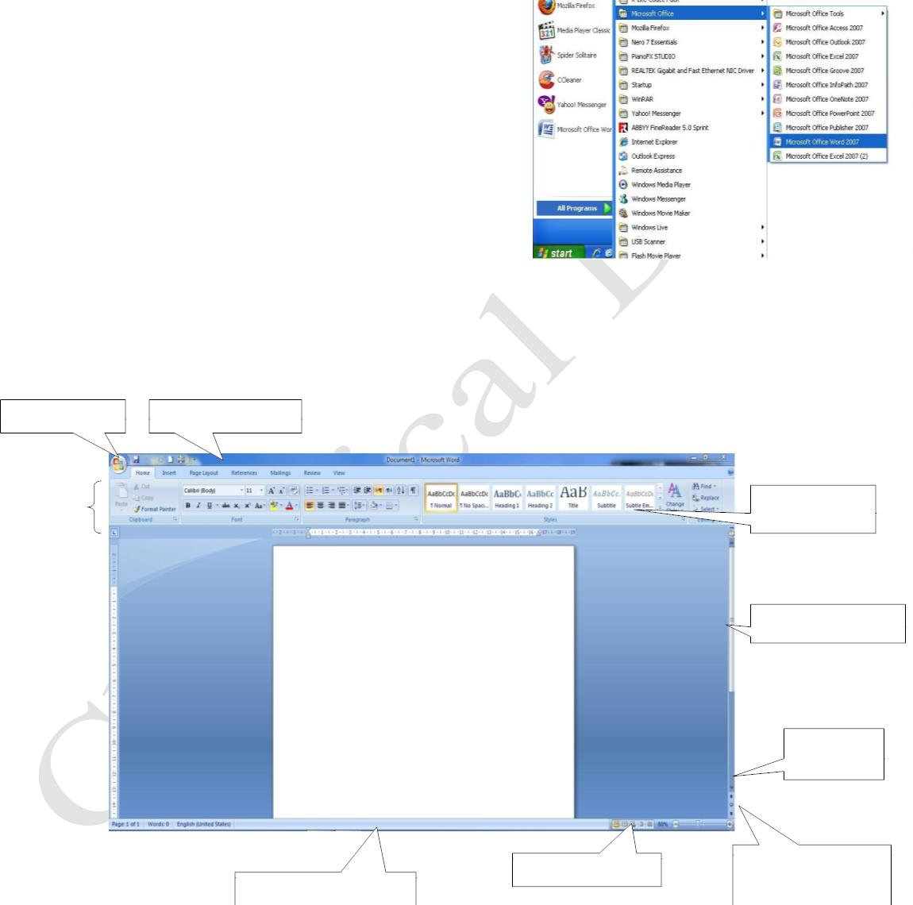
Lecturer
Omar Imran
2019 - 2020
oft office Word 2007
Diyala university/College of Engineering
Department of Chemical Engineering
A word processor, "Word 2007”
Is one of the most common and widely used programs to ease, which makes dealing with a very
simple calculator. Is the office software that are used in text editing and printing of books and
documents, this program is included with a range of office software
Start work in "Word 2007 "
• The first thing you need to do is run the program
and run the program follow the following steps
• Start key is pressed from the taskbar
• Appearance of the Start menu click on All Programs
All programs Emergence of the list of programs click
on the folder Microsoft Office Microsoft office
• Choose from the sub-menu program Roses Word 2007
The main screen of the program
When you run the program following the opening screen appears:-
Trail Version
Trail Version
Trail Version
Trail Version
Trail Version
Trail Version
Trail Version
Trail Version
Trail Version
Trail Version
Trail Version
Trail Version
- :
Trail Version
Button Office
Rapid toolbar
Tape
Toolbar
The vertical scroll bar
Browse
button pages
Buttons Quick View
Button to choose
methods of browsing
The status bar rapid
First Class
2

Slide 3
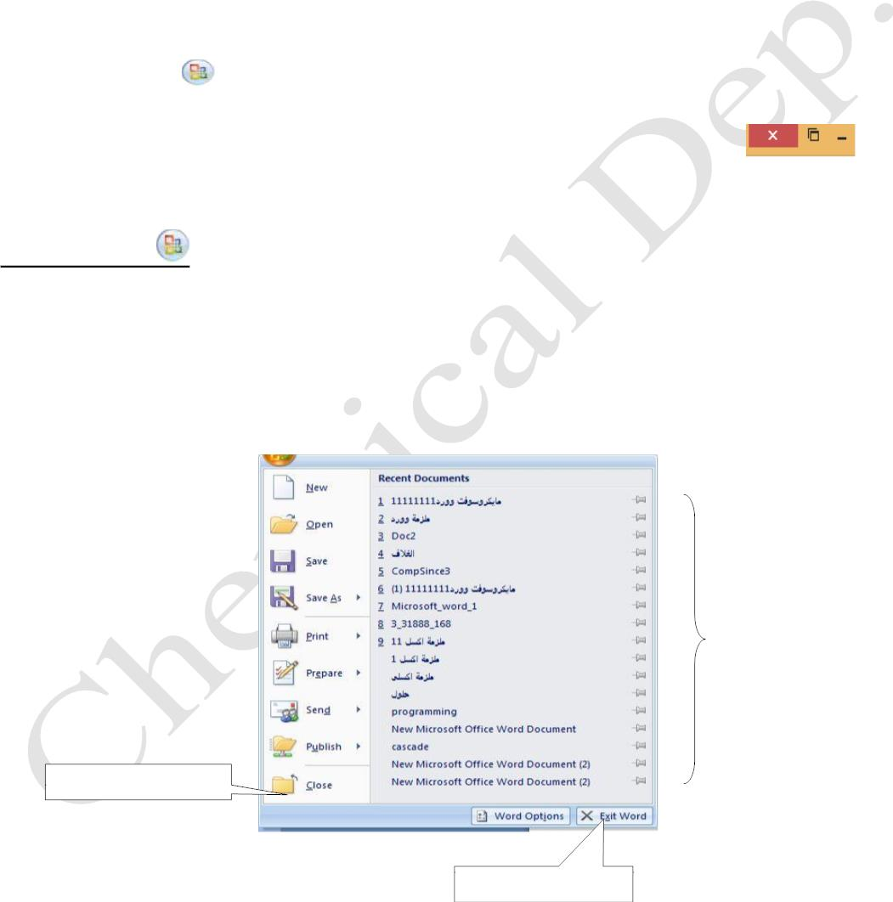
Lecturer
Omar Imran
2019 - 2020
oft office Word 2007
Diyala university/College of Engineering
Department of Chemical Engineering
Address Bar
• Address bar consists of:-
• program code named Microsoft word
• name of the document, for example, the first lesson
• tape on the right keys are located restoration and conservation, and undo toolbar button and
Rapid Office
, which contains a total of commands such as Save and Save As, and open a
new file ..... etc .
• In the north of the tape no keys zoom in and zoom out and close the program
Button Office
You can find the Office button in the upper right corner of the software system following Microsoft
Office 2007: Word, Excel, PowerPoint, Access, Outlook
Trail Version
Trail Version
Trail Version
Trail Version
Trail Version
Trail Version
Trail Version
Trail Version
Trail Version
Trail Version
Trail Version
Trail Version
Trail Version
Why do I see when I click a button Office?
1- When you click the Office button, right-left, you'll see the same basic commands available in the
File menu in previous versions of Microsoft Office to open the file and save it and print it. As in the
figure below:-
Recent documents
that were opened
Close the current document
Rapid exit the program
First Class
3

Slide 4
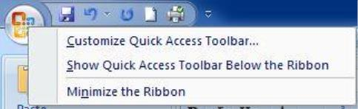
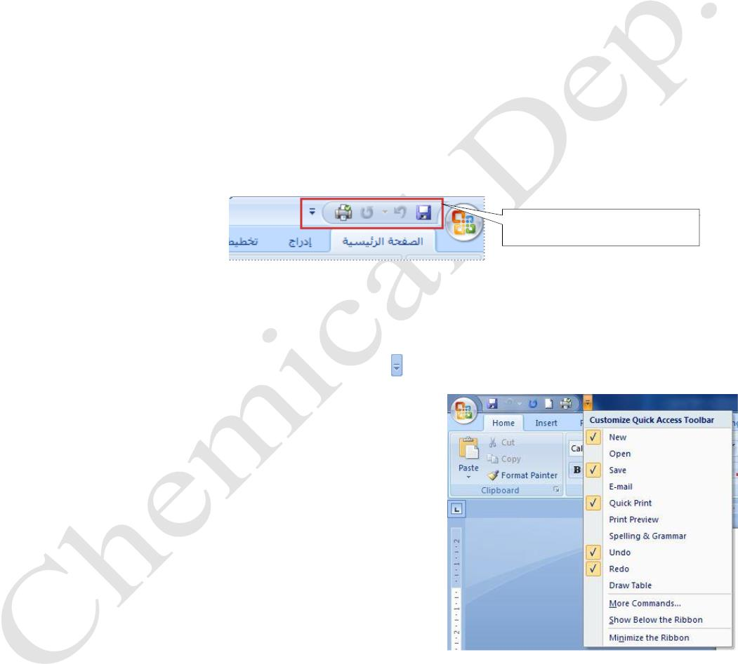
Lecturer
Omar Imran
2019 - 2020
oft office Word 2007
Diyala university/College of Engineering
Department of Chemical Engineering
When you click the Office button, right-menu will appear. As in the figure below2-
Customize "Quick Access Toolbar
The "Quick Access Toolbar" is a toolbar can be customized and contains a set of commands
.independent of the tab currently displayed
Quick Access Toolbar
Trail Version
Trail Version
Trail Version
Trail Version
Trail Version
Trail Version
Trail Version
Trail Version
Trail Version
Trail Version
Trail Version
Trail Version
Trail Version
You can add buttons represent commands to the "Quick Access Toolbar" as in the figure below.
• Click the Customize button Quick Access Toolbar
• In the list, click the command you want.
Appears in the commanding Quick Access Toolbar
First Class
4

Slide 5
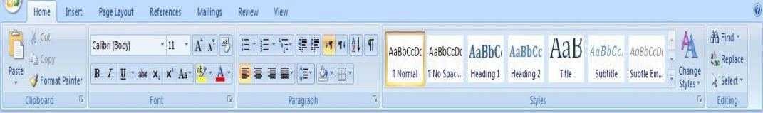
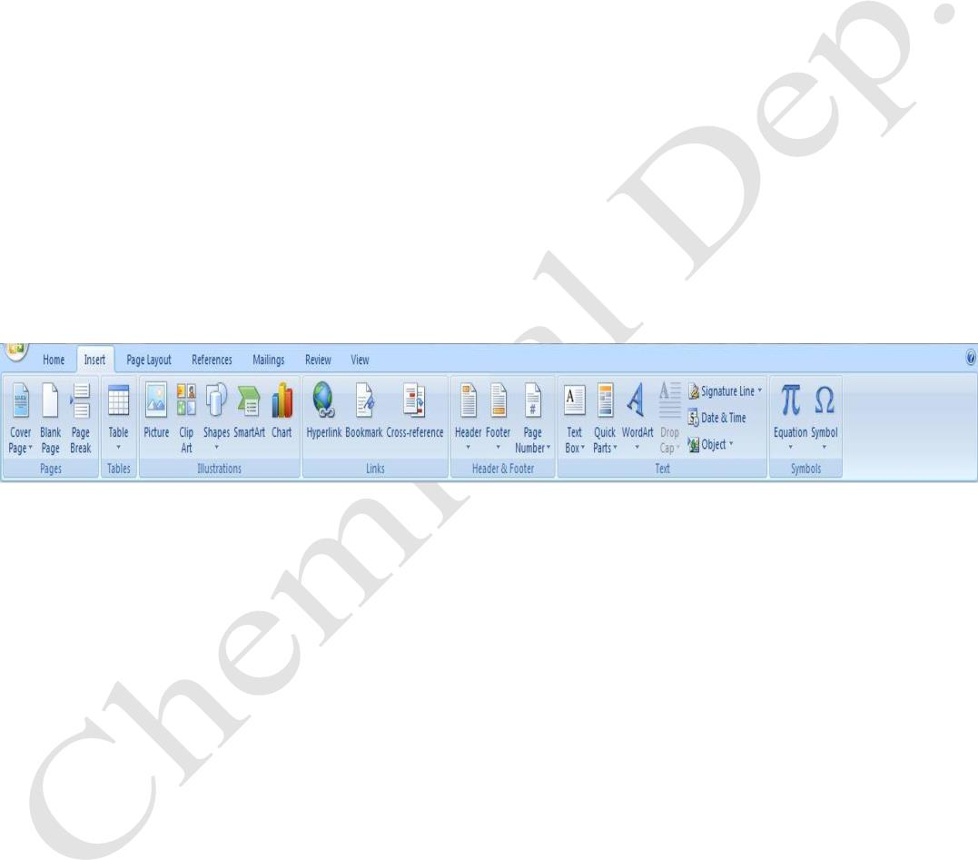
Lecturer
Omar Imran
2019 - 2020
oft office Word 2007
Diyala university/College of Engineering
Department of Chemical Engineering
Tab Home
•
•
Containing a total of folders which in turn contain a set of commands in the main tab, there are:-
portfolio (clipboard): - and where all orders copying and pasting and cutting and conservation
portfolio line (Font): - and where all the orders as a form and format the text type, size and font
color and other
•
clipboard paragraph (Paragraph): - and contain all orders of coordination and planning of Page
• portfolio Styles (Styles): - where all orders and change patterns of Documents
•
portfolio Liberation (Editing): - where orders and search and replace and choice
Tab Insert
Trail Version
Trail Version
Trail Version
Trail Version
Trail Version
Trail Version
Trail Version
Trail Version
Trail Version
Trail Version
Trail Version
Trail Version
Trail Version
It contains a total of savers in turn contain a set of commands
• portfolio pages (Pages): - And where everything related to the orders page, for example, a cover
page or a blank page or breaks between pages
• portfolio tables (Tables): - And where All orders include spreadsheets to word document
• portfolio of illustrations (Illustrations): - And where All orders include images , charts, shapes
and cut-outs and other
• portfolio links (Links): - And where orders inclusion of external links from the Web
• portfolio head and appendix (Header & Footer): - And where All orders include a header or
appended to the pages of the document and the document as well as a page number
• portfolio text (Text): - And where orders include various texts and various symbols
• portfolio symbols (Symbols): - And where orders inclusion of symbols and equations
•
portfolio text (Text): - And where orders include various texts and various symbols
. portfolio symbols (Symbols): - And where orders inclusion of symbols and equations
First Class
5

